Slide 1
Data analysts
in Israel

Slide 2
Project Goals
Reaserch data about the proffesion from a variety of aspects:
Answer common questions about the skills, experience and education among data analyst in israel
Help juniors to get a better understanding about the proffesion

Slide 3
Platforms:
Database- Linkedin
Analysis & Visualization- Snowflake, Power BI Public platforms: GitHub, LinkedIn
TEAM:
Team leader: Ilay Damari
Team members: Ido Kahlon
Ayelet Biton
Nofar Maymon

Slide 4
Work stages
Finding a Database
Posting the project on Github
Data Cleansing
Data Analysis
1
3
5
8
2
4
7
Data Scraping
Classify Business questions
Visualization

Slide 5
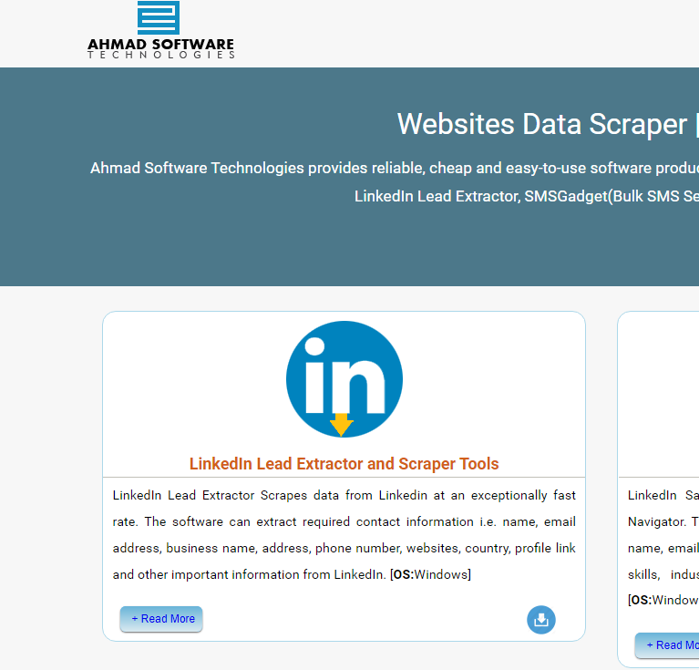
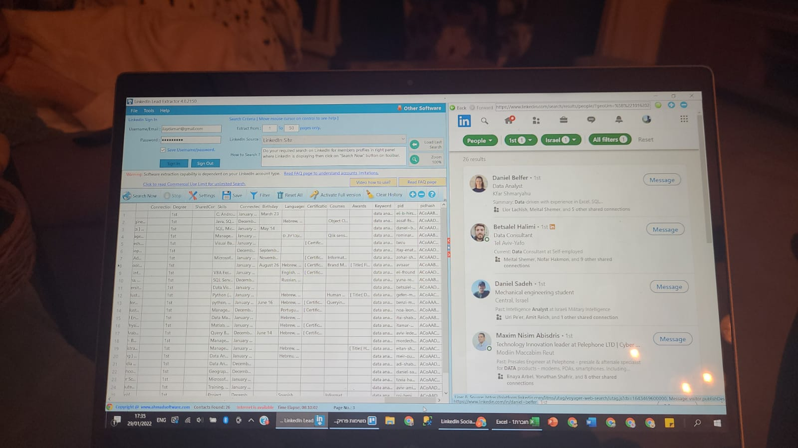
לשלב הבא ->

Slide 6
לשלב הבא ->
The process..
How we cleaned and analyze the data relates to Data analysts:
education
skills
Military experience
Position’s scope
seniority
Jobs’s Location

Slide 7



Process
Download data
Wearhouse
Analyze
Dashboards
Recommendations
linkedin

Slide 8
Findings:
We found that the Most Common Skills Among Analysts are: sql, paython and excel in this order.
The central area of Israel is the most popular area for data analyst position.
Only 5 Percent of DA position’s scope were part time.
For a starting DA it Will Take almost 4 years to become a Senior DA and between 1.6 to 2.5 years to be promoted to different positions.
The majority of analysts graduated with a bachleors degree
Contrary to popular assumptions that experienced military veterans occupy a large amount of DA positions, they made up only 8% of our data's whole.

